Slide 1
Experimental Results
All_IVCs Algorithm

Slide 2
Overhead of different algorithms
Algorithm | min | max | avg | stdev
All_IVCs | 13.642% | 101034.615% | 2544.399% | 7764.159%
Minimization | 0.0% | 3646.154% | 26.560% | 181.579%
IVC_UC | 0.0% | 100.0% | 10.226% | 11.718%
IVC_UCBF | 14.092% | 11124.432% | 882.018% | 1512.071%
* Overhead = (running time of the algorithm)/ (JKind verification time) * 100

Slide 3
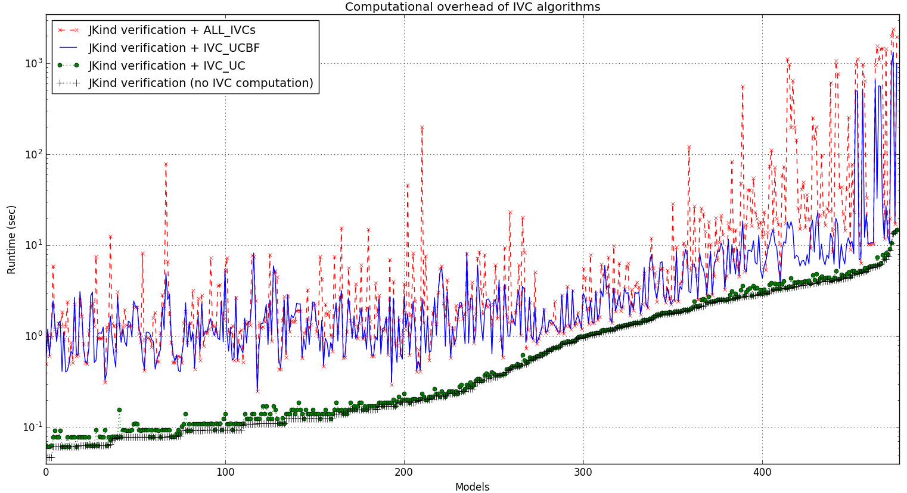

Slide 4
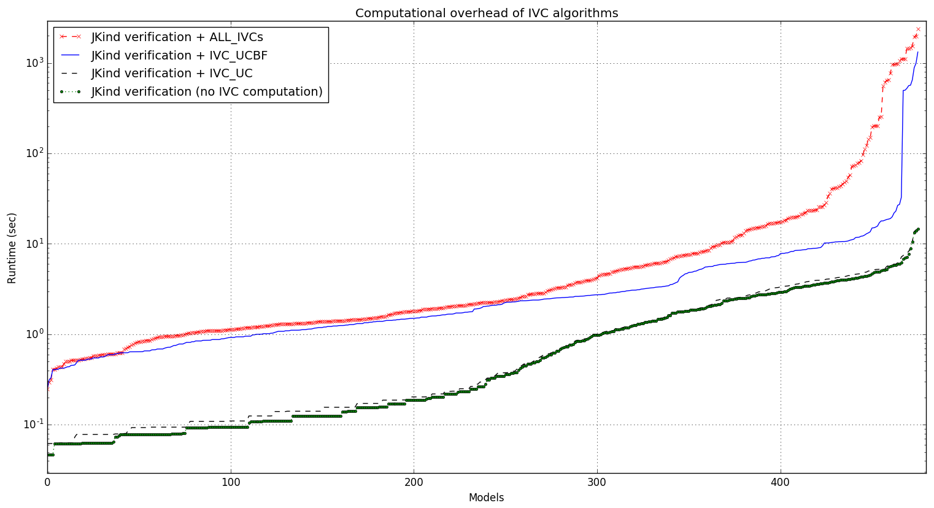

Slide 5
Running time of different algorithms
Running time (sec) | min | max | avg | stdev
All_IVCs + proof time | 0.25 | 2388.501 | 60.184 | 257.736
minimization + All_IVCs + proof | 0.25 | 2388.502 | 60.260 | 257.868
IVC_UC + proof time | 0.062 | 14.758 | 1.384 | 2.046
IVC_UCBF + proof time | 0.248 | 1323.515 | 17.247 | 104.838
Proof time | 0.047 | 14.617 | 1.299 | 1.940
All_IVCs | 0.125 | 2375.058 | 58.884 | 256.529
IVC_UC | 0.0 | 1.422 | 0.084 | 0.184
minimization | 0.0 | 5.797 | 0.077 | 0.364

Slide 6
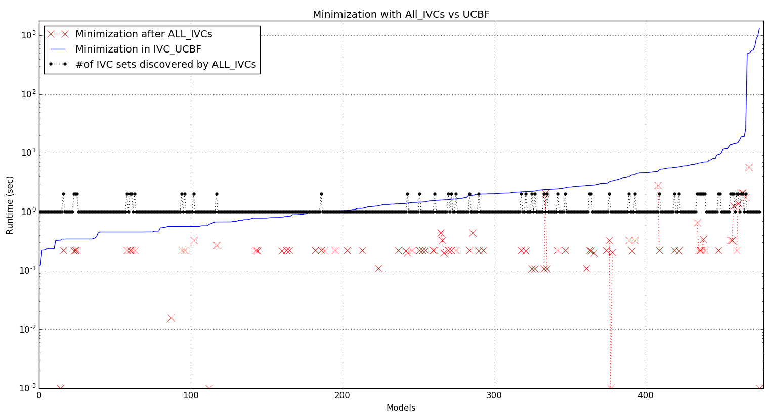

Slide 7
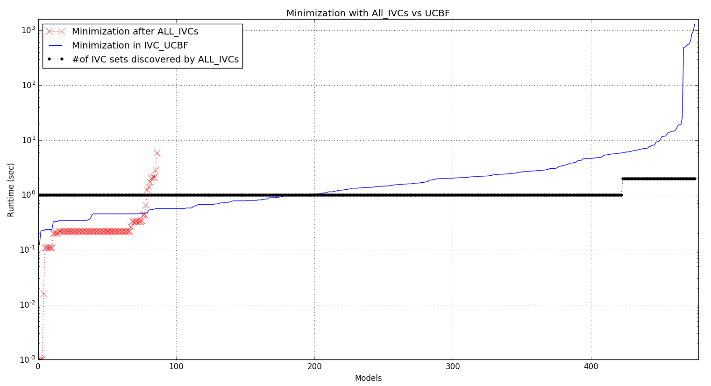

Slide 8
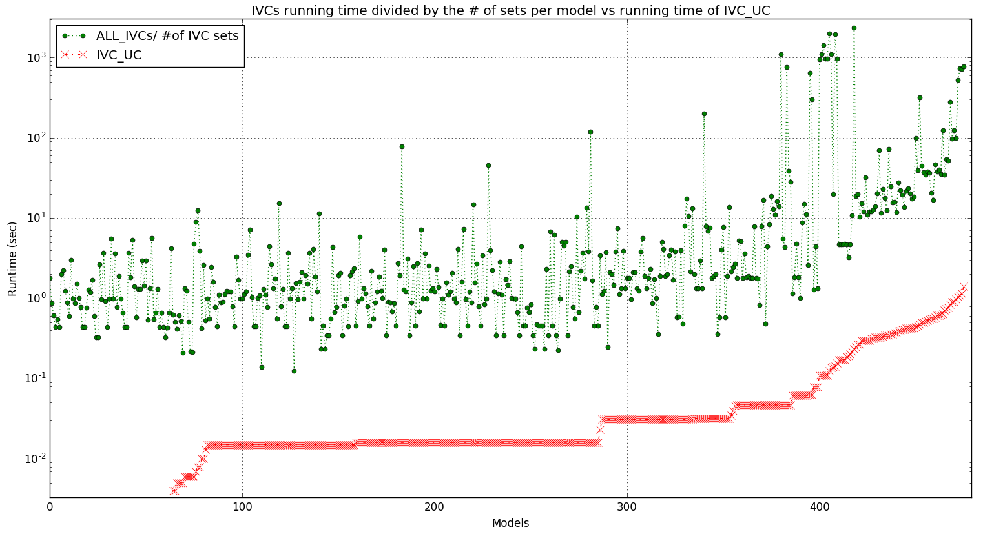

Slide 9
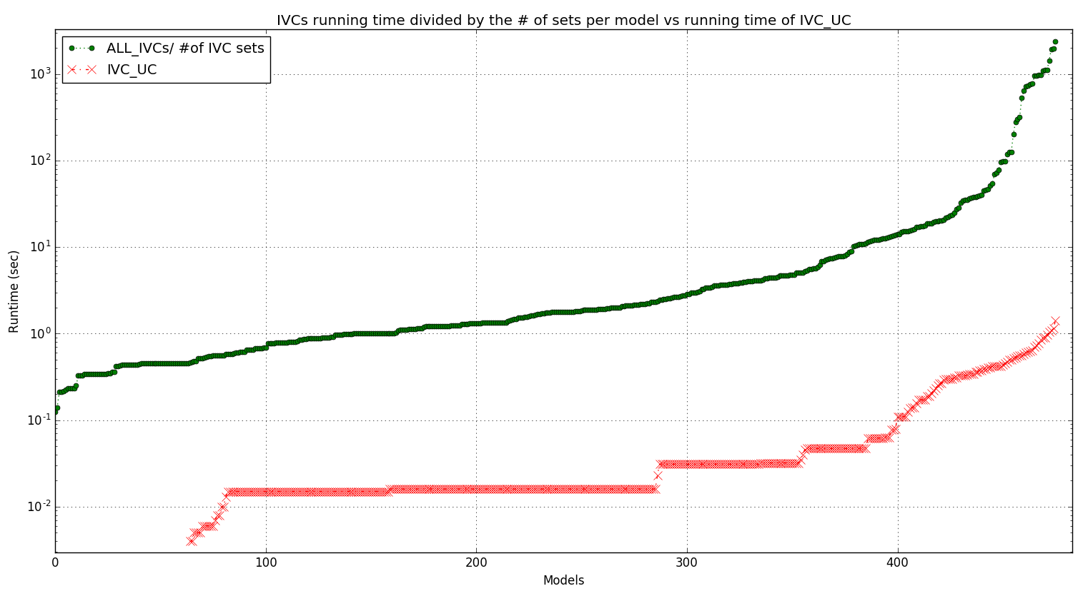

Slide 10
Info on IVC_UCBF minimization runs
Running time (sec) | avg | stdev
All runs among all models | 0.78 | 7.91
VALID runs among all models | 3.3 | 2.95
INVALID runs among all models | 0.16 | 0.41
UNKNOWN runs among all models | 141.07 | 0.81

Slide 11
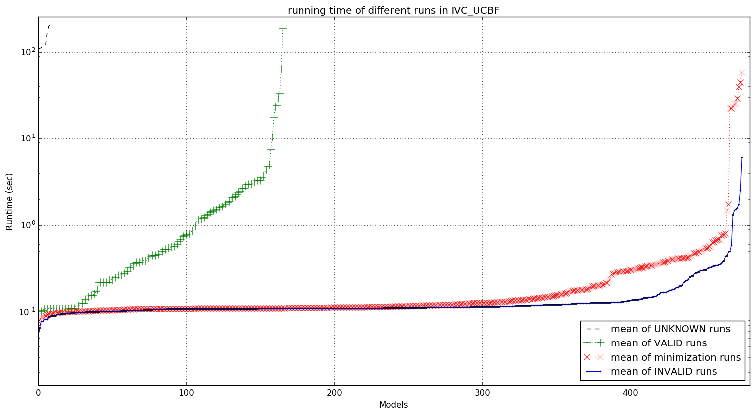

Slide 12
